Slide 1
Machine Learning CA1
Timothy Ng Tik Ti P7362270

Slide 2
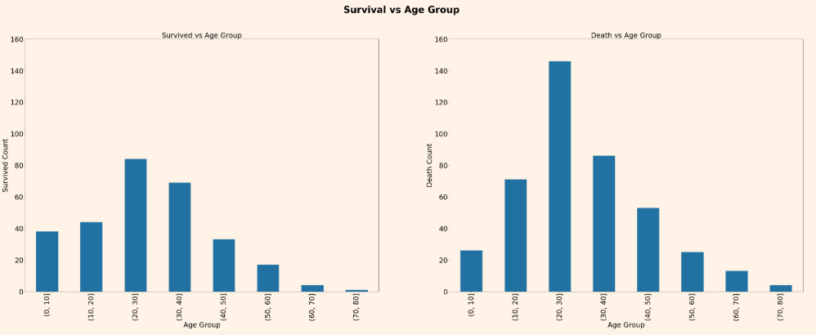
Titanic Dataset – Data Exploration
Used describe and count to determine the data frame features and missing data
Used corr to find out correlation amongst different features to make sure model doesn’t use features that highly correlated
Perform preliminary data analysis across features Age, Sex, and Pclass’s effect on Survived label
Fig 1: Bar chart showing survived and death having similar distribution

Slide 3
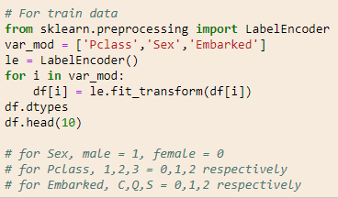
Titanic Dataset – Feature Engineering
Replaced null values as well as dropped columns that doesn’t make sense affecting survival rate, such as PassengerId, Name
As sklearn require all inputs to be numeric, converted categorial variables into numbers encoding the categories as well
Fig 2: Code encoding categorial features

Slide 4
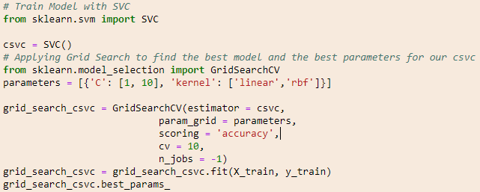
Titanic Dataset – Model Training
As it’s a classification problem, we utilized logistic regression and support vector machine model
In order to determine the most suitable hyperparameter, GridSearchCV function was utlilized for both model
Fig 3: Code for choosing and implementing most suitable hyperparameters for SVC model

Slide 5
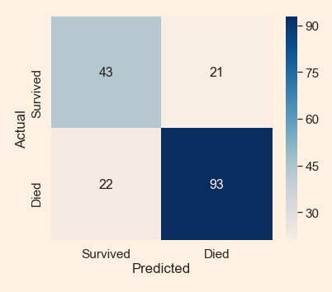
Titanic Dataset – Model Evaluation
To evaluate which model is more suitable, we utilized confusion matrix and accuracy score on our test.csv dataset
Results are close, with logistic regression giving a slight edge with higher accuracy of 0.759
Fig 4: Confusion matrix and accuracy score for logistic regression model

Slide 6
Titanic Dataset – Kaggle Submission
As logistic regression was more accurate, we have chosen it for our Kaggle submission
Pegging it against our stupid baseline where everyone dies, our logistic regression scored higher. This shows that our logistic regression made more sense in predicting actual survivor rates than our stupid baseline
However, the score was 0.77, which means there is error for the system. One potential reason for this is that there are potentially other factors affecting the survival rate other than the features input into the system. We could do further testing with hyperparameters, and further testing with other features to come up with a more robust system
Fig 5: Kaggle Score of stupid baseline vs logistic regression prediction

Slide 7
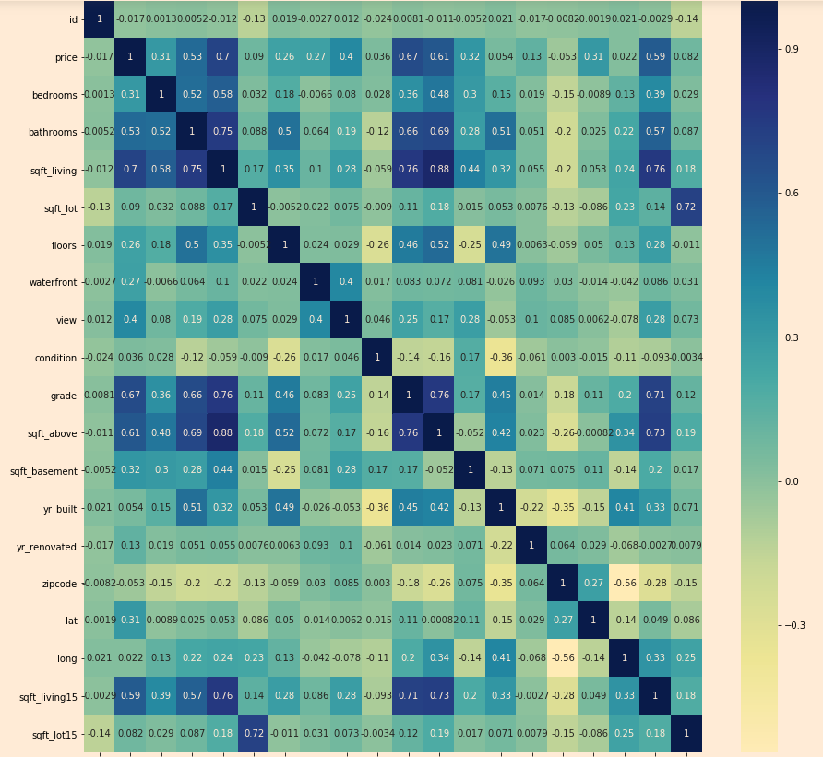
Housing Dataset – Data Exploration
Used info, isnull and describe to determine the data frame features and missing data
Used corr and heatmap to find out correlation amongst different features to make sure model doesn’t use features that highly correlated
Fig 6: Heatmap showing correlation amongst features and label

Slide 8
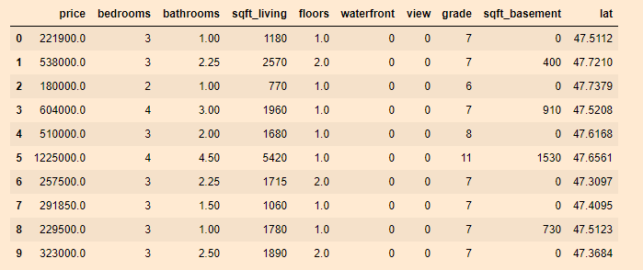
Housing Dataset – Feature Engineering
Replaced null values as well as dropped columns that doesn’t make sense affecting price, such as id, date. We dropped input columns that are related to each other too
Additionally, we dropped features with very low correlation with price too, such as yr_renovated, zipcode
Fig 7: Remaining features and price label

Slide 9
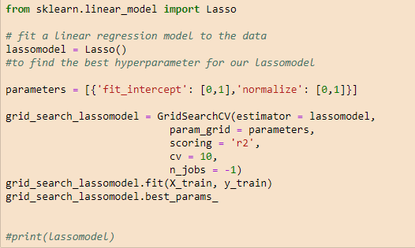
Housing Dataset – Model Training
As it’s a regression problem, we utilized linear regression and lasso model
In order to determine the most suitable hyperparameter, GridSearchCV function was utlilized for both model
Fig 8: Code for choosing and implementing most suitable hyperparameters for lasso model

Slide 10


Housing Dataset – Model Evaluation
To evaluate which model is more suitable, we utilized R2 score on our test data
Results are practically similar, with both models sporting 0.66 for train data
Pegging it against our stupid baseline where all the prices are the same, both our models scored higher for R2. This shows that our models made more sense in predicting than our stupid baseline
Fig 9: Similarities for R2 score for linear regression (Top)
ss lasso (Middle), pegging against stupid baseline (Bottom)

